Slide 1
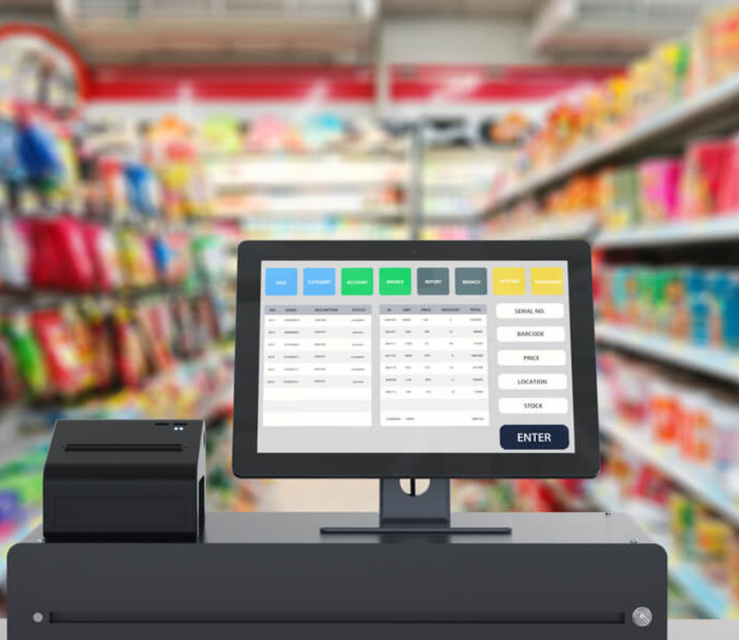
Customer Cohort Analysis Using SQL
Customer Retention and CLV Analysis from Transaction Data

Slide 2
Objective: Understand customer behavior over time via cohort analysis.
Key Questions:
How well are we retaining customers?
What is the lifetime value of different customer cohorts(monthly)?
Dataset: 512,909 records from RETAIL table

Slide 3
Data Exploration Highlights
SELECT COUNT(*) FROM RETAIL; Total Records: 512,909
SELECT COUNT(*) FROM RETAIL
WHERE QUANTITY <= 0; Suspicious Records (Quantity ≤ 0): 10,126
SELECT COUNT(*) FROM RETAIL
WHERE INVOICENO LIKE 'C%’; Canceled Orders (InvoiceNo starts with "C"): 8,836
SELECT COUNT(*) FROM RETAIL
WHERE CUSTOMERID = ‘ ‘; Blank CustomerID: 128,676
SELECT COUNT(CUSTOMERID) FROM RETAIL
WHERE CUSTOMERID IS NOT NULL AND CUSTOMERID != ‘ ’
AND INVOICENO NOT LIKE 'C%' AND QUANTITY > 0
AND UNITPRICE > 0; Valid Records Used for Cohort: 375,736

Slide 4
Cohort Analysis Logic
CTE1: Clean and format data
CTE2: Get first transaction date per customer
CTE3: Assign each purchase to a “Cohort Month”
Final Step: Pivot table of customer counts by cohort index (Month_0 to Month_12)

Slide 5
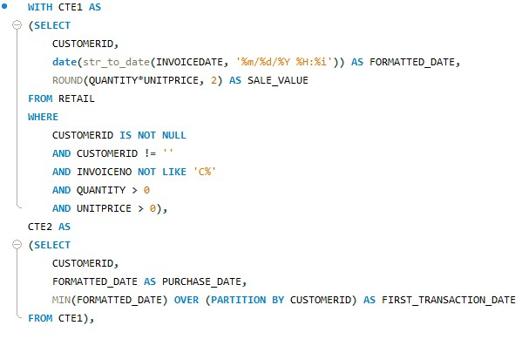
Cohort Analysis [Customer Retention]

Slide 6
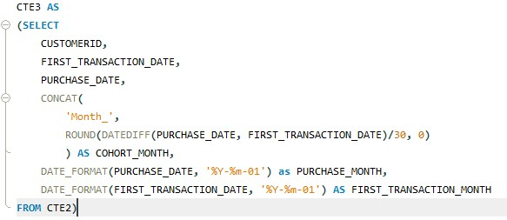
Cohort Analysis [Customer Retention]

Slide 7
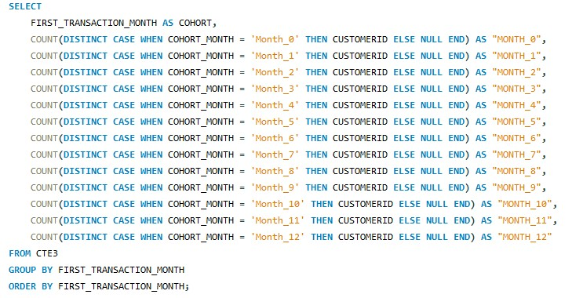
Cohort Analysis [Customer Retention]

Slide 8
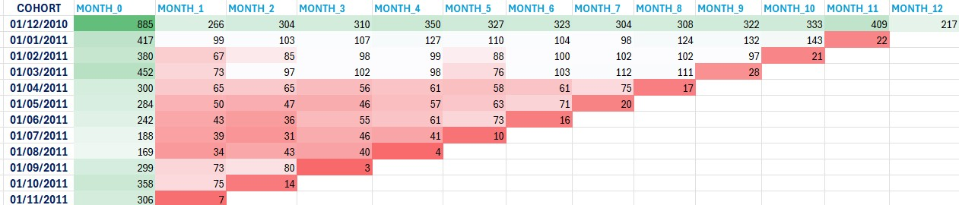
Customer Retention Analysis

Slide 9
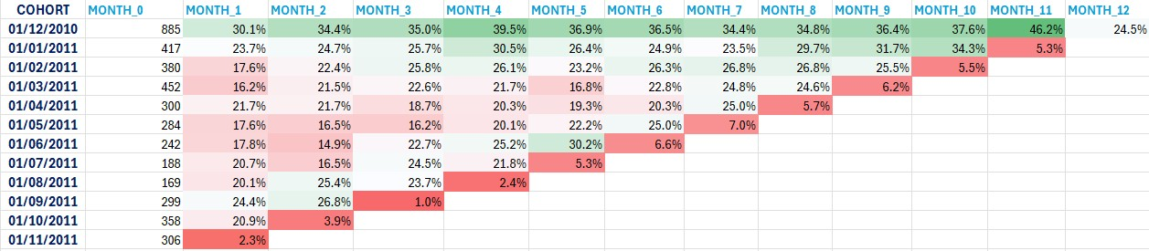
Customer Retention Rate (%)

Slide 10

Customer Churn Rate (%)

Slide 11
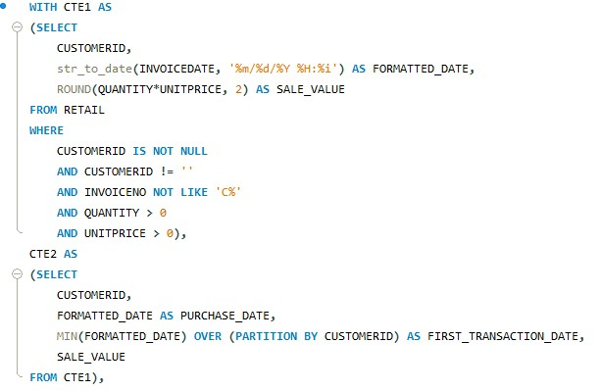
Cohort Analysis [Customer Lifetime Value (CLV)]

Slide 12
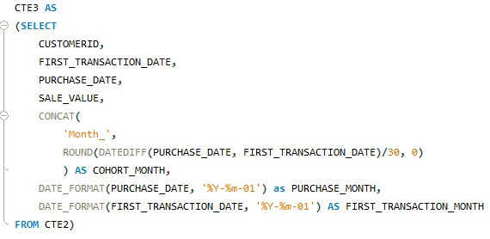
Cohort Analysis [Customer Lifetime Value (CLV)]

Slide 13
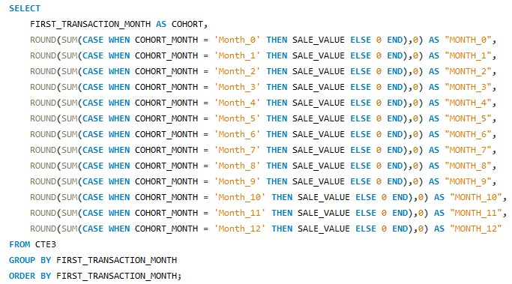
Cohort Analysis [Customer Lifetime Value (CLV)]

Slide 14
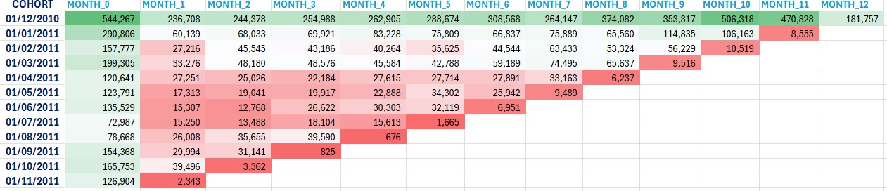
Customer Lifetime Value (CLV)

Slide 15
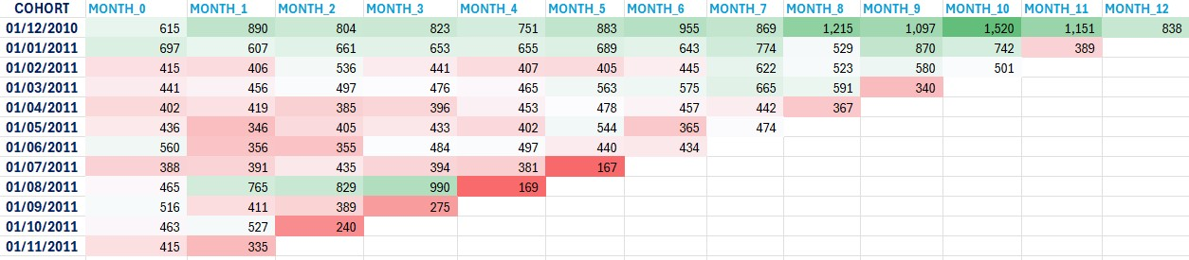
Customer Average Spend

Slide 16
Insights & Takeaways
Summarization of patterns:
Retention drops sharply after Month 1
Some cohorts (e.g., Feb or Mar) show better retention/lifetime value
Suggestion:
Re-engagement campaigns after first month
Personalized retention strategy by cohort

